Slide 1
Ancient Greek Architecture

Slide 2
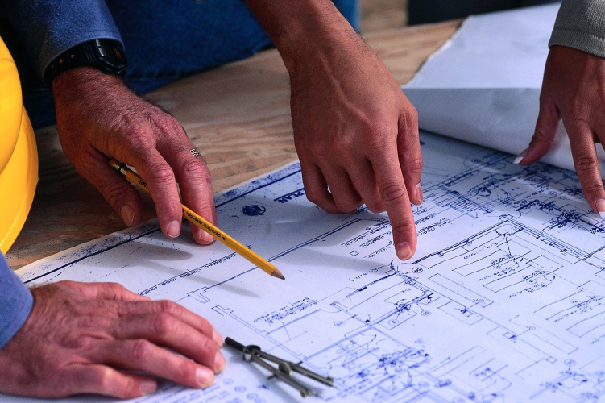
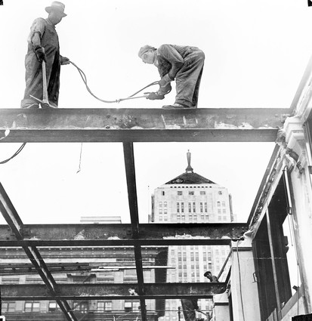
Architecture is designing and creating buildings.
DESIGNING
BUILDING

Slide 3
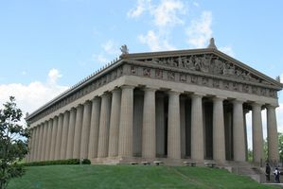
Special structures in Greek architecture
Columns-large upright posts that helped for support, safety and also decoration. Architrave-the structure that lies right over the top of the column.
Frieze-structure between the architrave and piedmont, often sculpted and decorated with shapes, people or leaves.
Pedimont-triangle roof-like structure above the frieze, decorated with important people or stories from Ancient Greek times.
ARCHITRAVE
PIEDMONT
COLUMN
FRIEZE

Slide 4
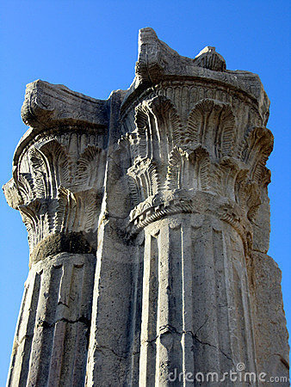
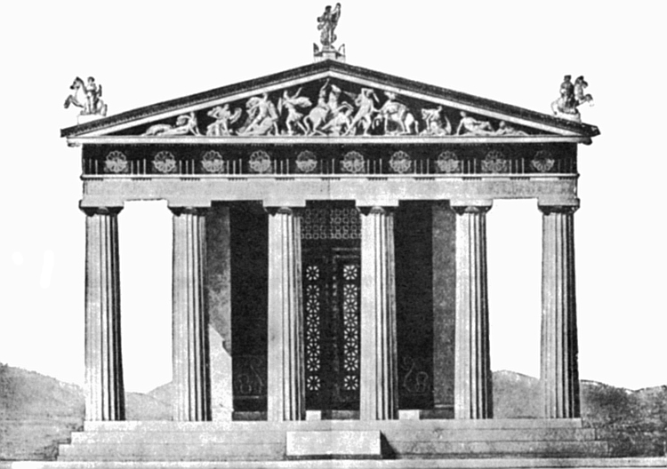
Even though Greek architecture seems simple some of it was very detailed.
Buildings were carved with leaves and flowers,
scenes of battles, gods and even mythological creatures.
The columns were decorated with lines and leaves and other designs at the very tops and very bottoms.

Slide 5
Ancient Greeks had many rules to follow when making buildings.
how wide the columns could be
how tall the columns could be
how many columns a building needed.

Slide 6
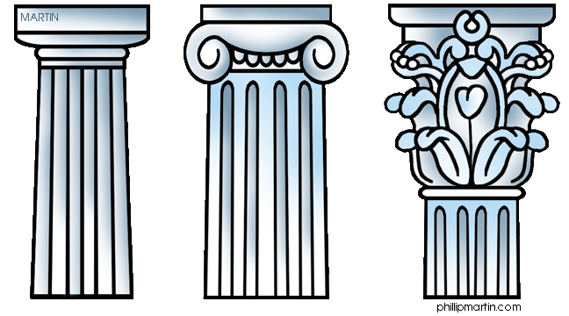
There a 3 main types of columns:
DORIC
IONIC
CORINTHIAN

Slide 7
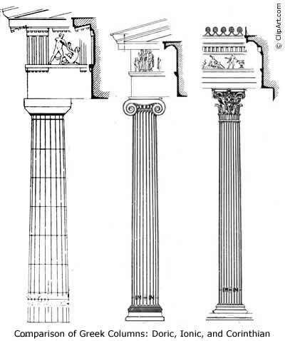
• Doric: is the oldest and most simple order.
• Ionic: is more decorative than the Doric. The columns are taller and thinner. The top of the columns are decorated with scrolls and other patterns. The bases of the columns are also decorated.
• Corinthian: is a lot like the Ionic order, but are even more elaborately decorated, usually with leaves and floral patterns
Which is your favorite?

Slide 8
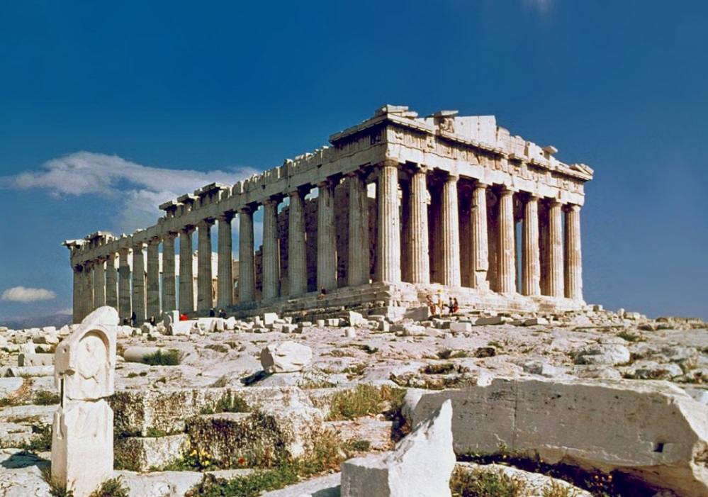
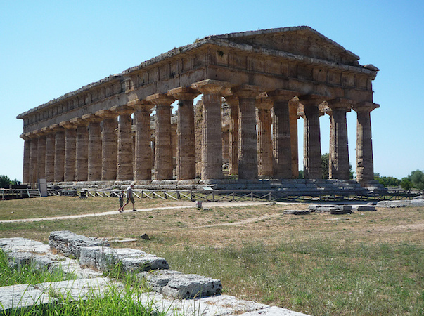
Types of Greek buildings
Temples: are the most common type of public buildings in ancient Greece used to protect and keep statues of Greek Gods.
Theatres: performances and plays were a big part of Greek life so many theatres were built
Assembly Hall: used to have important town meetings.
Stoas: used as places for Greek people to come together to worship.
Parthenon-temple created for the goddess for Athena
Hera-Stoa named for the queen of the gods and goddesses

Slide 9
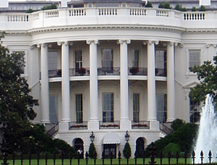
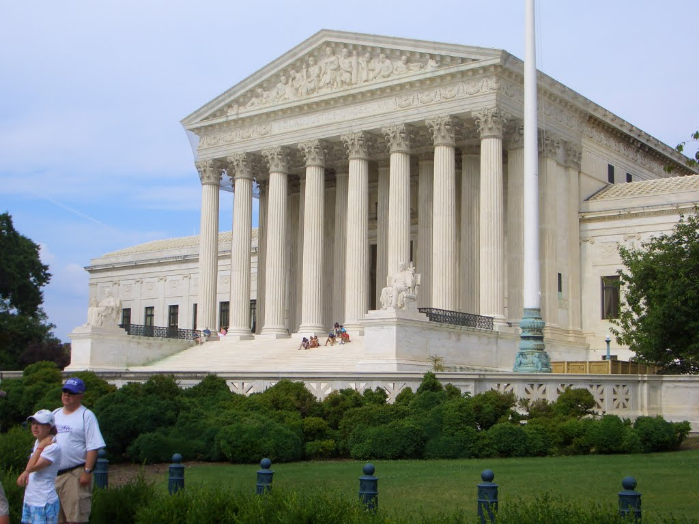
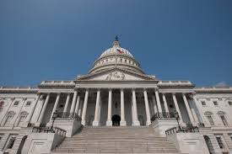
Where can we find ancient Greek architecture in the US?
WHITE HOUSE
SUPREME COURT BUILDING IN
WASHINGTON DC
US CAPITOL BUILDING

Slide 10
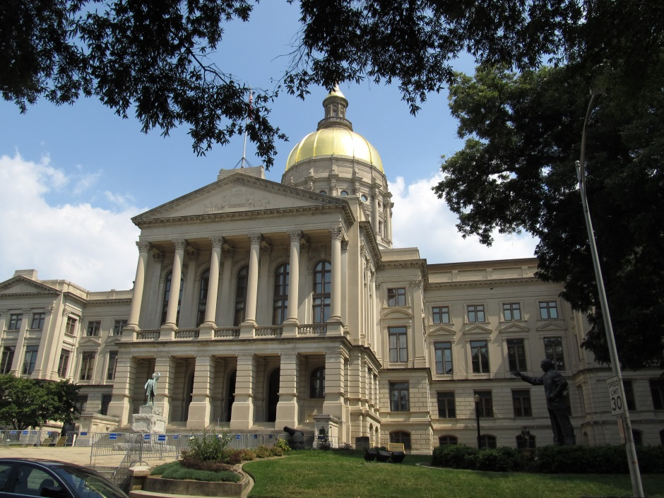
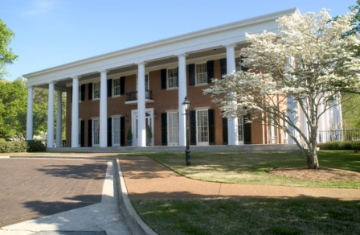
Greek architecture in Georgia
GEORGIA
CAPITOL
BUILDING
GEORGIA GOVERNOR’S MANSION

