Slide 1
The New Deal
FDR’s Plan to Restore the US After the Great Depression

Slide 2
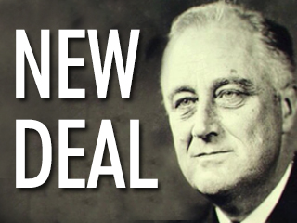
The New Deal
CLICK THISLINK TO WATCH A VIDEO ABOUT FDR
http://www.history.com/topics/fireside-chats
The New Deal was a series of programs introduced during the Great Depression by President Franklin D. Roosevelt to address the problems of mass unemployment, homelessness and the nation's economic crisis.

Slide 3
The Purpose of the New Deal
The goals of the New Deal were to create programs to provide RELIEF to the needy during the Great Depression, RECOVERY of the economy and industries and REFORM of the financial system (banks and Stock Market).
The New Deal programs helped Americans and provided jobs for millions of people.

Slide 4
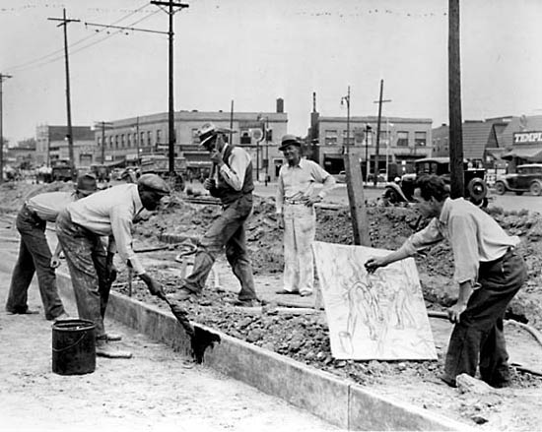
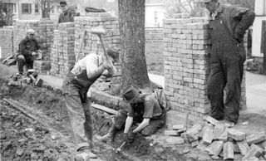
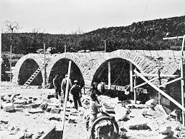
Works Progress Administration
The WPA was a government agency was established providing light construction jobs for millions of unskilled workers.
During this time construction workers, working predominantly in towns and cities, built roads, sidewalks, bridges, schools, hospitals, libraries, courthouses and city halls.

Slide 5
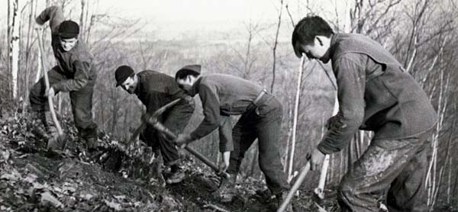
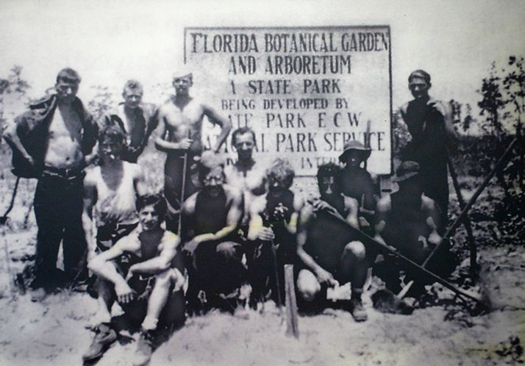
The Civilian Conservation Corps (CCC)
The Civilian Conservation Corps (CCC ) was developed to create jobs to conserve US forests, parks and rangelands for hundreds of thousands of unemployed.
Unskilled young men aged 18 to 25 years old, were provided training.
The (CCC) planted over three billion trees, built 97,000 miles of forest trails and roads and stocked rivers with nearly a billion fish which resulted in an increase of wildlife population.

Slide 6
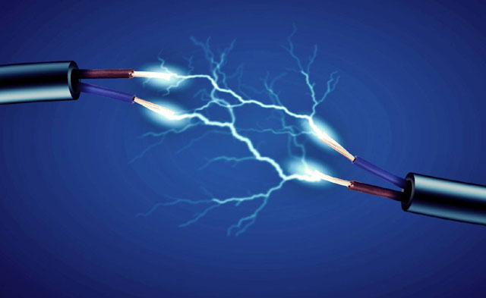
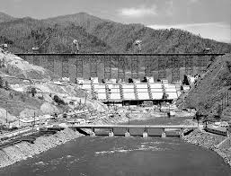
Tennessee Valley Authority (TVA)
The role of the TVA was to construct dams and power plants along the Tennessee Valley.
The Tennessee Valley Authority developed and distributed cheap hydroelectric power (electricity) into rural areas that were not served by private utilities.
The Tennessee Valley Authority (TVA) went on to build 20 dams to control flooding and generate hydroelectric power (electricity).

Slide 7
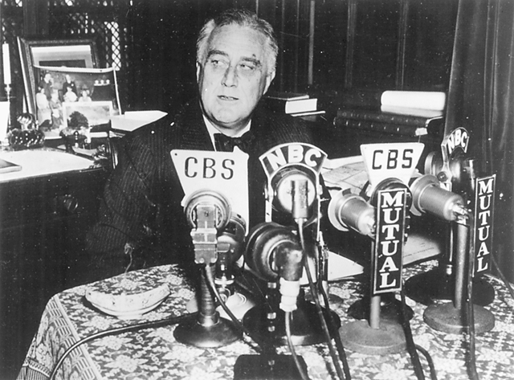
Fireside Chats with FDR
The Fireside Chats were a series of thirty important radio broadcasts made by Franklin D. Roosevelt as a means to directly talk to Americans in times of crisis.
The purpose of the Fireside Chats was to convey important information and reassure Americans during difficult times of the Great Depression.
The Fireside Chats inspired confidence and patriotism as well as helped FDR gain public approval of his ideas to help improve the US with the New Deal.
CLICK LINK FOR VIDEO ABOUT FIRESIDE CHATS
http://www.history.com/topics/fireside-chats/videos

