Slide 1
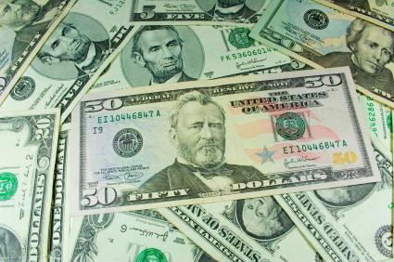
Where does your money go?

Slide 2
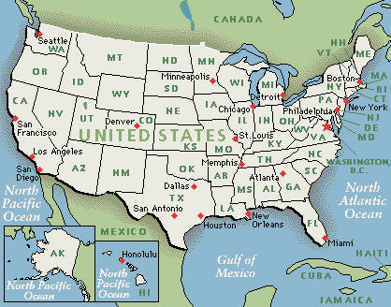
Federal Taxes:
These are taxes/money you must give to the federal government (government for all of the USA) from your paycheck:

Slide 3
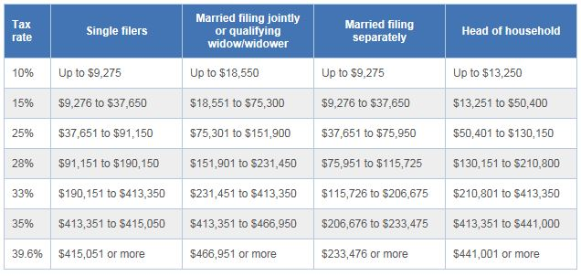
Federal income tax brackets

Slide 4

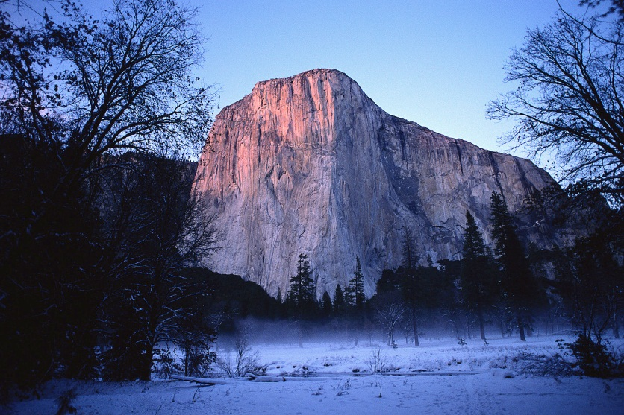

What does the Federal Government use my tax money for?
Interstate Roads and Highways
National Parks
Some Hospitals

Slide 5

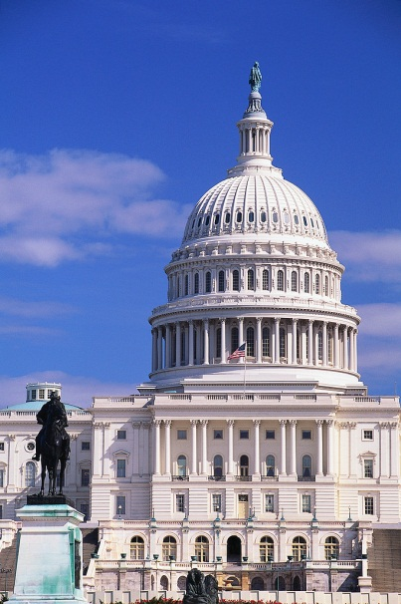
Your Federal Taxes also pay for:
Federal Law Enforcement Agencies and Officers
Like the FBI and CIA.
The United States Military
Army~Navy~Air Force~Marines
The salaries of government employees
The President, Senators, Congressmen

Slide 6

Your Federal Taxes also pay for:
Medicaid-Payments to help people who are too old or sick to work pay their medical bills.

Slide 7
State Taxes:
These are taxes/money you must give to the state government (Georgia) from your paycheck:

Slide 8
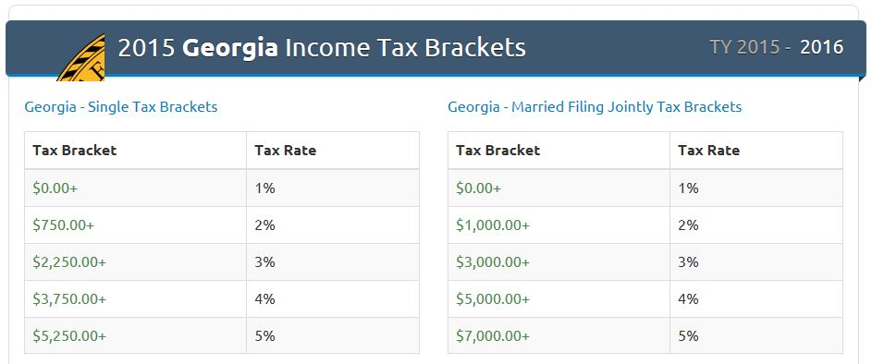
State income tax brackets

Slide 9



What does the State Government of Georgia use my tax money for?
Georgia elementary schools, middle schools,
high schools and colleges.
Georgia public libraries.

Slide 10
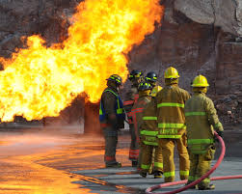
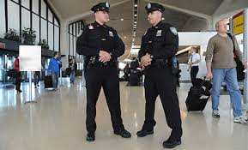
They also use it to:
Pay for our police
Pay for our fire fighters.

Slide 11


Our state taxes money pays for
Georgia roads
Parks

Slide 12
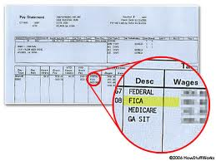
Other places your money goes:
(F.I.C.A)
Medicare and Social Security

