Slide 1
Causes of World War One

Slide 2
What’s Going on in
Europe?

Slide 3
Nationalism
Militarism
Imperialism

Slide 4
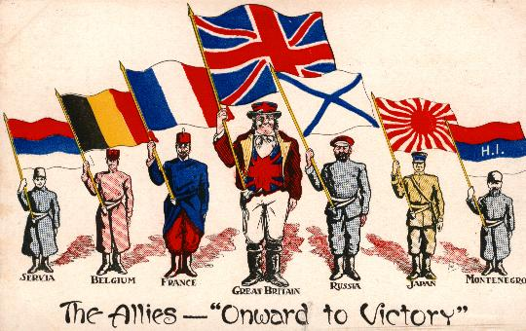
Nationalism-supporting one’s country and thinking it’s BEST.
Germany’s nationalism led them to believe they were unstoppable when they declared war on Russia, France and Belgium.
The desire to regain national pride (nationalism) made France want to go to war.

Slide 5
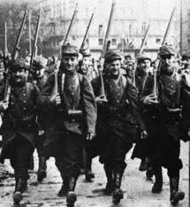
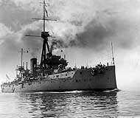
Militarism-the building up of one’s military to increase power.
Between 1870 and 1914 France and Germany both more than doubled their armies.
There was fierce competition between Britain and Germany for Navy dominance. Britain introduced the battleship Dreadnought and soon after Germany built their own.

Slide 6
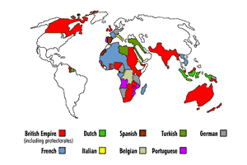
Imperialism-when a country takes over land to gain power.
By 1900 Great Britain had taken over lands in 5 continents.
France had taken over large areas in Africa.
Germany had acquired much less land and was jealous and angry.

Slide 7
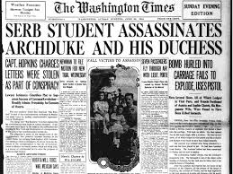
In June of 1914 Archduke Ferdinand and his wife. royalty from Austria-Hungary, were assassinated by a Serbian man.
Turmoil in Europe

Slide 8
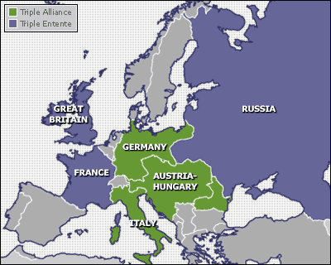
Upcoming SlideShare
Loading in...5
×
Alliance-agreement between countries to help each other when needed
2 main alliances were created prior to World War 1
ALLIED POWERS
England
France
Russia
Serbia
CENTRAL POWERS
Austria-Hungary
Germany
Italy

Slide 9
Declares war on
Austria-Hungary
Serbia
Has an alliance with
Has an alliance with
Declares war on
Russia
Germany
(So they fight together)
(So they fight together)
France
And declares war on
Has an alliance with
Great Britain
WORLD WAR ONE BEGINS

Slide 10
Why Does the United States enter World War One ?

Slide 11
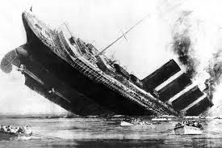
The Lusitania-was a British passenger ship was sunk by Germans off the coast of Ireland. There were 128 Americans on board.
The sinking of the Lusitania enraged Americans.
Germany promised not to attack anymore passenger ships.
Germany broke this promise and began attacking US ships.
U.S. declares war on the Central Powers!

Slide 12
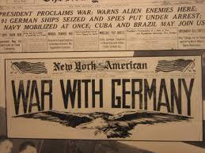
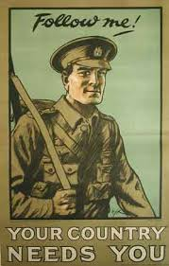
U.S. DECLARES WAR!!!

Slide 13
What are Americans doing at home
(on the home-front)
to help our soldiers win WWI?

Slide 14
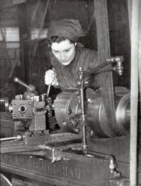
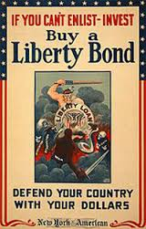
Americans Did Their Share at Home
Workers including women and African Americans produced supplies need by our soldiers at war.
Americans planted victory gardens and rationed their food: extra food was sent to the soldiers.
Americans bought war bonds which helped pay for the needs and supplies of war.

Slide 15
What are Americans doing at war
(on the war-front)
to help our win WWI?

Slide 16
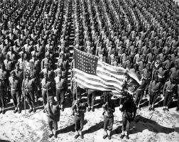
Americans do their part on the War Front
When the United States entered the war in 1917 they contributed millions of fresh new soldiers, weapons, food, trucks and other supplies to WW1.
These contributions helped the Allied Powers move ahead of the Central Powers who were exhausted after 3 years of fighting.

Slide 17
How did World War One end?

Slide 18
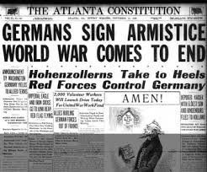
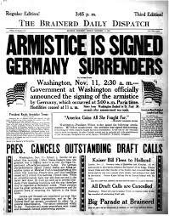
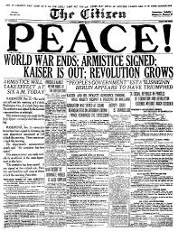
Cease Fire!
On November 11, 1918 the Central Powers realized they could not win the war and signed an armistice.
An armistice is an agreement to stop fighting.

Slide 19
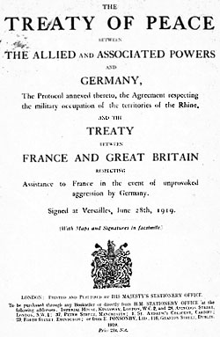
Treaty of Versailles is created by Great Britain, France and the U.S.
Germany is forced to sign the treaty:
Germany must:
Admit guilt.
Pay money to other countries.
Give up land.
Dis-arm its army.
The League of Nations is formed:
To ensure that war never broke out again.
To solve problems peacefully.

Slide 20
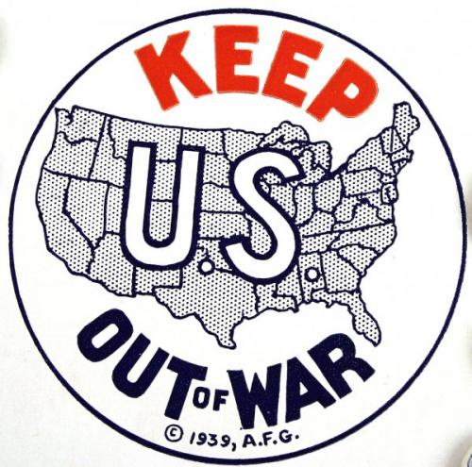
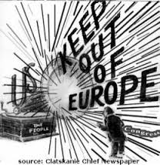
Isolationism-the belief that the US should stay out of world events.
After WW1 Americans wanted the US to isolate themselves from world events.

